Slide 1
SCM OTHER ACTIVITIES

Slide 2
Scm plan template 4.configuration control
As per the scm plan template version 7.0 the next set of item is configuration control.
This task includes: initiating preparing,analysing ,evaluating and authorizing proposals for a change to a system

Slide 3
4…1 code and document control
This section should describe the library handling procedures (for software and documents).
Separate types of source code library may be set up, e.g.:
development (or dynamic);
master (or controlled);
archive (or static).

Slide 4
4.2 media control
This section should describe the procedure for handling the hardware on which the software resides, such as:
magnetic disk;
magnetic tape;
CD-ROM/Read-Write.

Slide 5
Contd…
Whatever media is used, the procedure described should include the controls for:
labeling media
storing the media (e.g. fire-proof safes, redundant off-site locations);
recycling the media (e.g. always use new magnetic tapes when archiving).

Slide 6
4.3.1 levels of authority
This section should define the level of authority required to authorise changes to a baseline (e.g. software librarian, project manager).

Slide 7
4.3.2 change procedures
If the procedure for processing change proposals to software (including software development and support tools) is already written in the Change Control procedure then make a reference here to the specific section of that document.
Identify and give details of only those parts of the procedure that are different and specific to this particular project.

Slide 8
5.Tools techniques and methods for cm
This section should describe the tools, techniques and methods to support:
configuration identification (e.g. controlled allocation of identifiers);
configuration item storage (e.g. source code control systems);
configuration change control (e.g. online problem reporting systems);
configuration status accounting (e.g. tools to generate accounts).

Slide 9
Document control
TITLE: Configuration management plan
ISSUE:ISSUE 1
Date:20/10/2016
Author:MMM,LLL
Distribution: Not yet
Control: Reissue as complete document

Slide 10
Document sign off
Nature of Signoff: Author, reviewer
Person:MMM,LLL
Signature:
Date:
Role: Senior controller, project consultant

Slide 11
Document change record
Date:14 september,8 october,20 October 2016
Version:issue1,issue1.1,issue2
Author:MMM,LLL
Change details: Tidy up, updated formatting,

Slide 12
Configuration control
The change request is prescribed for project plan, design and coding standards ,low level design (performance algorithm) high level design (system flow navigation),unit test plan, object code and scm plan etc so all these changes needs to evaluated and requested the request must be in the form of change control form
the change control form looks like

Slide 13
change control form
Date of request : 10.10.2016
Unique code of change:ch3.45
Name of resource requesting change:madhu
Name of resource assigned to change:tanuja
System effected: average
Time and cost effect estimate: $20 per hour for 120 hours
Recommended change: immediate change in system flow, slight change in low level design
Estimated delivery date:1.11.2016
Signaures:project manager, lead IT, stakeholder

Slide 14
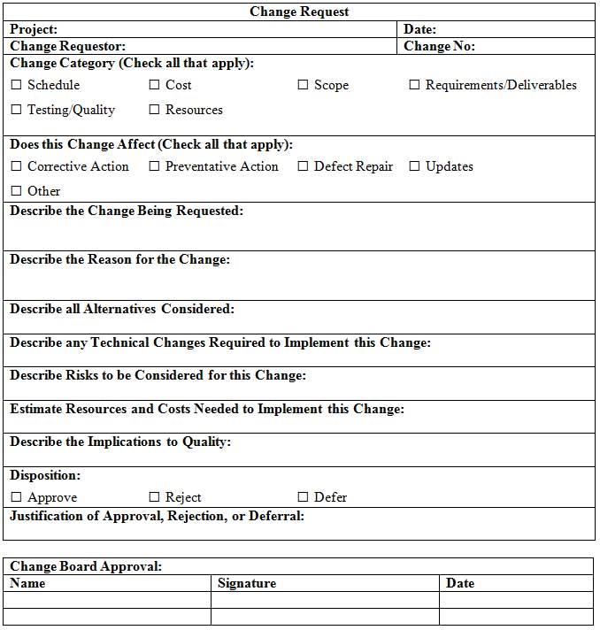
Change request form looks like

Slide 15
ccb
these are questions which are put forth by the change control board members:
1.what are the reasons for changes? less performance needs more improved features
2.Which organizational jobs,roles,area will get affected? Developer,tester,as well as scm team and finally designing part
How does the change fit in to the overall environment? These changes are part of series of changes

Slide 16
Contd..
How much time is there to implement the change?5 days
Which financial resources is there to support the change? Fund from product based companies
What human resources is sufficient to adapt the changes?6 people per team
How will the change benefit in individual roles? Better understanding of configuration control., more structured procedure can be developed

Slide 17
Status accounting
It provides a corporate memory of project events
It answers questions like :
What happened? A time for a major change
Who did it?madhu,tanu
When did it happened?
What else will be affected? only the features will get affected severely

Slide 18
auditing
Here system usage is reviewed whether any misuse had occurred.
Use computer generated log analyzers, activity logs, any hacking attempts
It configures duplicate logs and offline storage

Slide 19
